Slide 1
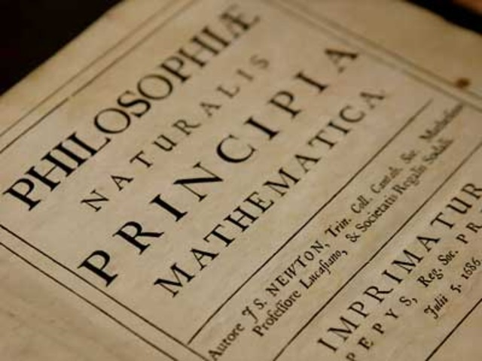
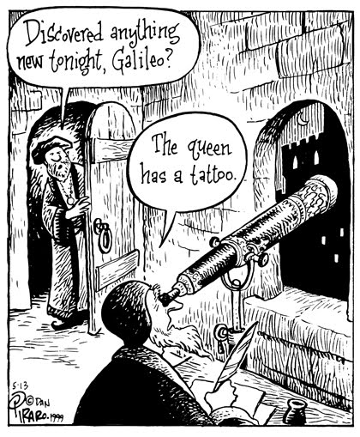
CHAPTER 6
THE EIGHTEENTH CENTURY:
AN AGE OF ENLIGHTENMENT SCIENTIFIC REVOLUTION

Slide 2
THE ENLIGHTENMENT
Enlightenment thinkers used the scientific method to analyze & understand all aspects of human life
German philosopher Immanuel Kant came up with a motto for the Enlightenment – “sapere aude”
sapere aude (Latin) - “Dare to know! - Have the courage to use your own intelligence!”

Slide 3
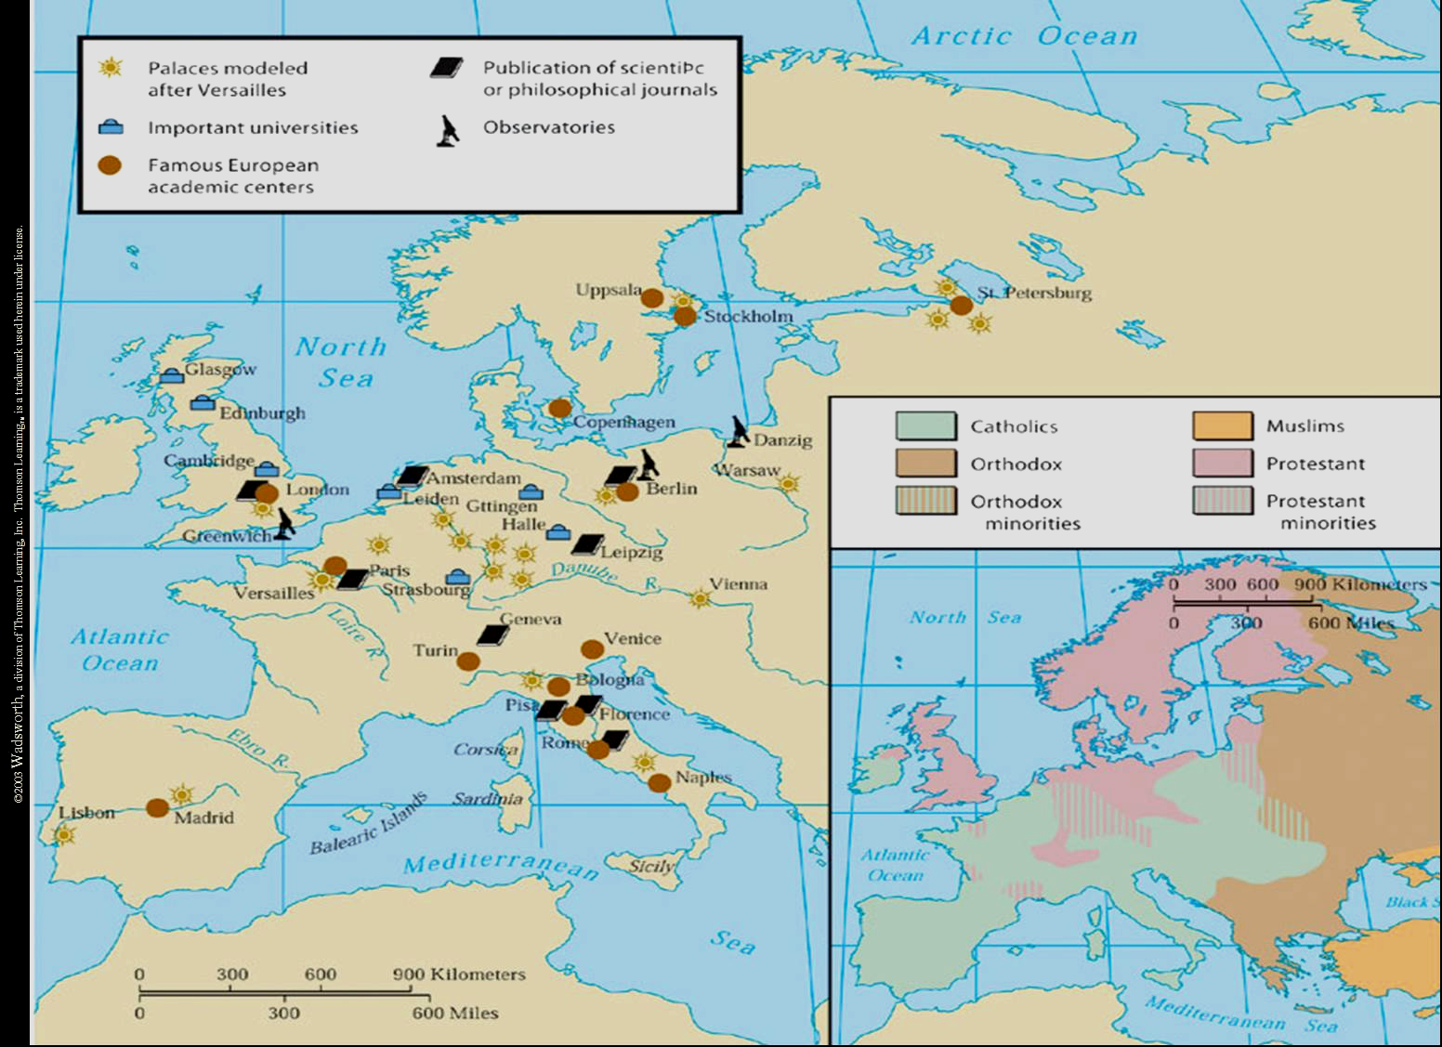
Centers of the Enlightenment

Slide 4
The Characteristics of the Enlightenment
Rationalism → reason is the arbiter of all things.
Cosmology → a new concept of man, his existence on earth, & the place of the earth in the universe.
Secularism → application of the methods of science to religion & philosophy.

Slide 5
The Characteristics of the Enlightenment
Scientific Method
Mathematical analysis
Experimentation
Inductive reasoning.
Utilitarianism → the greatest good for the greatest number.
Tolerance → No opinion is worth burning your neighbor for.

Slide 6
The Characteristics of the Enlightenment
Optimism & Self-Confidence
The belief that man is intrinsically good.
The belief in social progress.
Freedom
Of thought and expression.
Bring liberty to all men (modern battle against absolutism).
Education of the Masses

Slide 7
The Characteristics of the Enlightenment
Legal Reforms
Justice, kindness, and charity → no torture or indiscriminant incarceration.
Due process of law.
Constitutionalism
Written constitutions → listing citizens, rights.
Cosmopolitanism.

Slide 8
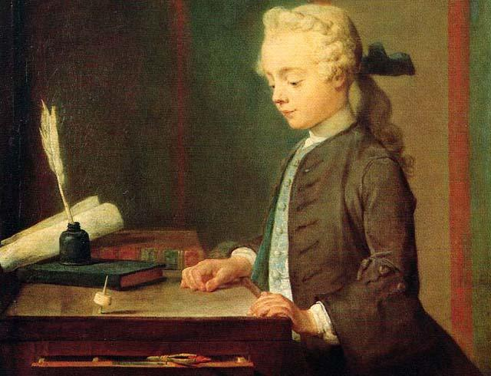
The “Enlightened” Individual→ The Philosophe
Not really original thinkers as a whole, but were great publicists of the new thinking → CHANGE & PROGRESS
They were students of society who analyzed its evils and advanced reforms.

Slide 9
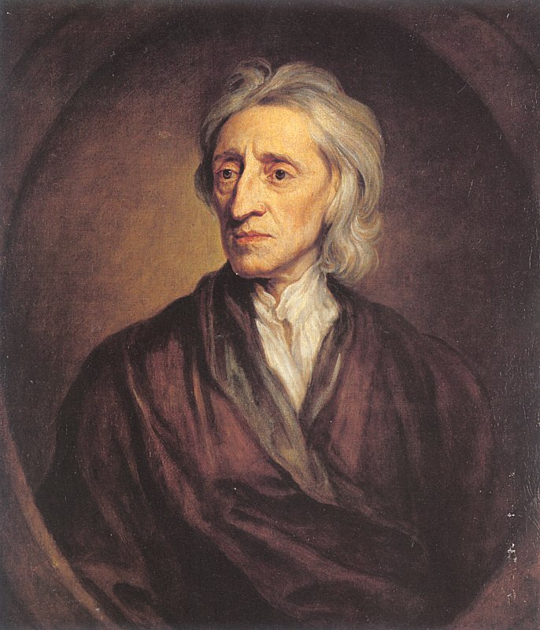
John Locke (1632-1704)
Human beings possess free will.
Legislators owe their power to a contract with the people.
There are certain natural rights that are endowed by God to all human beings.
life, liberty, property!

Slide 10
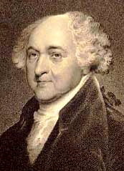
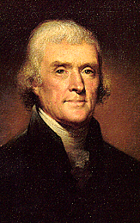
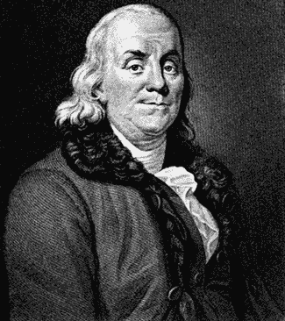
The American “Philosophes”
John Adams (1745-1826)
Thomas Jefferson (1743-1826)
Ben Franklin (1706-1790)
…...…life, liberty, and the pursuit of happiness…………...

Slide 11
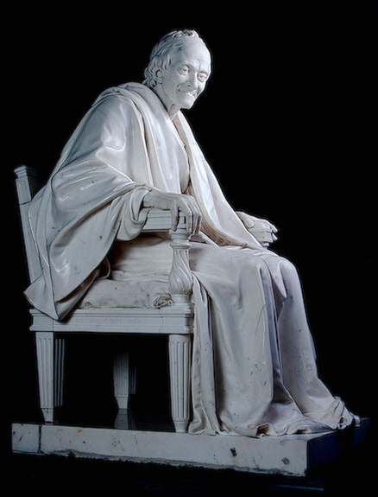
Voltaire (1712-1778)
AKA: Francois Marie Arouet.
Best known for his criticism of religious intolerance

Slide 12
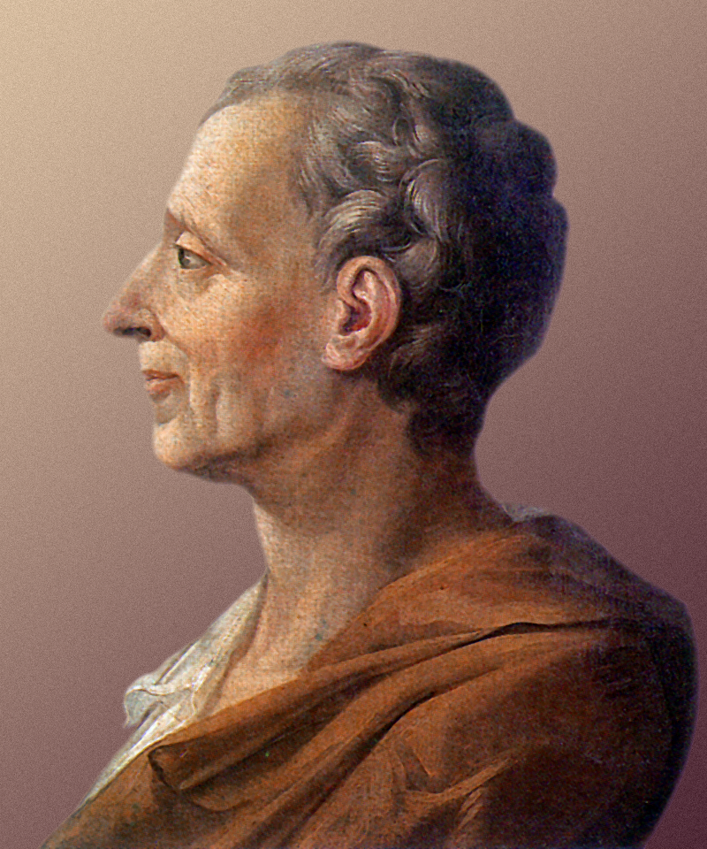
The Baron de Montesquieu (1689-1755)
On the Spirit of Laws
A separation of political powers ensured freedom and liberty.
Balance of Power

Slide 13
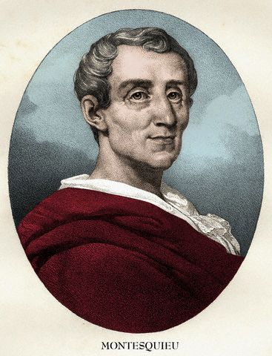
SEPARATION OF POWERS
Montesquieu’s idea was used in the United States Constitution.
Executive Branch
Judiciary Branch
President
Supreme Court
Congress
Legislative Branch
Lawmaking

Slide 14
BECCARIA
Argued that punishments should not be cruel or brutal
Opposed capital punishment (death penalty)
“Is is not absurd, that the laws, which punish murder, should, in order to prevent murder, publicly commit murder themselves.”

Slide 15
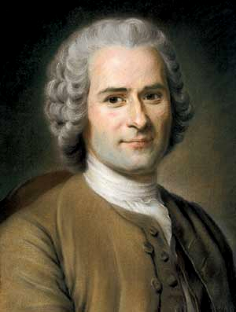
Jean Jacques Rousseau (1712-1778)
Government must come from the consent of the governed
Liberty, Equality, Fraternity.
Civil liberty → invest ALL rights and liberties into a society.
Rousseau’s thinking:
Influence the French revolutionaries of 1789.
Inspired the communists of the 19th century such as Karl Marx.

Slide 16
PATHS TO ENLIGHTENMENT
A New Skepticism
Attacked superstition, religious intolerance, and dogmatism
Skepticism about religion and growing secularization

Slide 17
THE PHILOSOPHES AND THEIR IDEAS
Came from all walks of life
Mostly nobility & the middle class
Paris was the “capital” of the Enlightenment
Desire to change the world
Call for a spirit of rational criticism
3 French Giants: Montesquieu, Voltaire, and Diderot

Slide 18
SOCIAL ENVIRONMENT OF THE PHILOSOPHES
Salons
Place for the literate elite to meet and share ideas
The Influence of Women
Marie-Thérèse de Geoffrin (1699 – 1777)
Invited encyclopedists to her salon
Marquise du Deffand (1697 – 1780)
Entertained Montesquieu, Hume, & Voltaire
Other social centers of the Enlightenment: coffeehouses, cafes, clubs, libraries, societies
Mary Wollstonecraft: Women should be equal! “I do not wish them(women) to have power over men but over themselves”

Slide 19
DIDEROT AND THE ENCYCLOPEDIA
Denis Diderot (1713-1784)
Encyclopedia, 28 volumes
Many of the contributors were philosophes
Attacked religious superstition and advocated toleration
Lowered price helped to spread the ideas of the Enlightenment

Slide 20
The Encyclopédie
Complete cycle of knowledge… change the general way of thinking.
28 volumes.
Alphabetical, cross-referenced, illustrated.
First published in 1751.
1500 livres a set. (expensive)

Slide 21
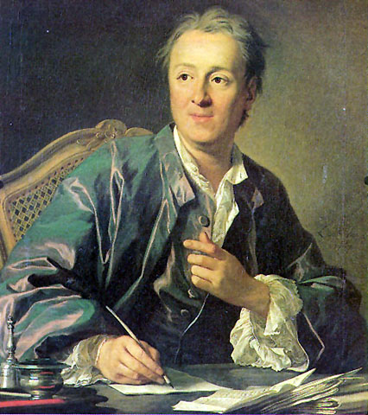
Denis Diderot (1713-1784)
All things must be examined, debated, investigated without exception and without regard for anyone’s feelings.
We will speak against senseless laws until they are reformed; and, while we wait, we will abide by them.

Slide 22
The Legacy of the Enlightenment?
Democratic revolutions in America in 1776 and continued in Amsterdam, Brussels, and in Paris in the late 1780s, put every Western government on the defensive.
Reform, democracy, and republicanism.

Slide 23
The Legacy of the Enlightenment?
New forms of civil society arose –-- clubs, salons, academies, libraries, and professional/scientific organizations.
19th century conservatives blamed it for the modern “egalitarian disease” (once reformers began to criticize established institutions, they didn’t know where and when to stop!)

Slide 24
The Legacy of the Enlightenment?
Materialism, (I want what I want when I want it)
Theoretically endowed with full civil and legal rights, the individual had come into existence as a political and social force to be reckoned with.

Slide 25
GROWTH OF CONSTITUTIONAL GOVERNMENT
“Constitutional government”
Government whose power is defined and limited by law.
British Constitution = Magna Carta, English Bill of Rights, all Acts of Parliament and unwritten traditions that protect citizens’ rights.
British government not totally democratic.
Oligarchy
Government in which the ruling power belongs to a few people.

Slide 26
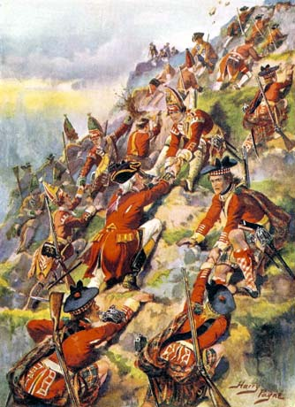
CAUSES OF THE AMERICAN REVOLUTION
SEVEN YEARS WAR (French and Indian War)
Conflict between the British and the French in their North American colonies
Fought over Ohio River Valley and Gulf of St. Lawrence.
British win. War EXPENSIVE!
All French territory in Canada transferred to the British.
British soldiers climb to battle on the
Plains of Abraham, Quebec, Canada.
https://www.youtube.com/watch?v=YtnTYGCoh9E

Slide 27
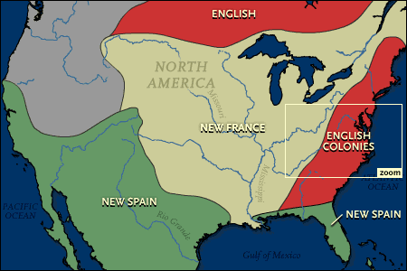
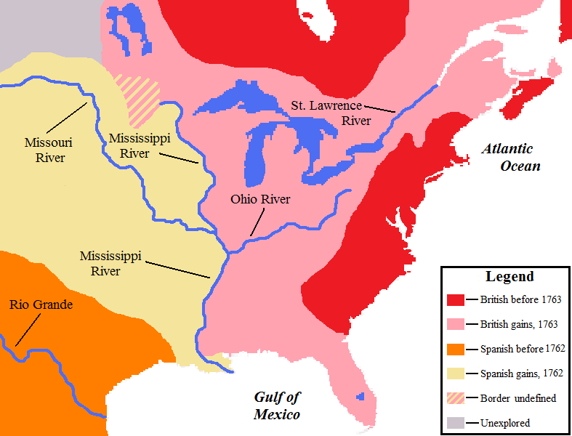
End of the French and Indian War – 1763 The French are driven out of North America
1755
1763

Slide 28
The Death of General Wolfe on the Plains of Abraham, Quebec 1759
Who should pay for this great British victory? – The Parliament thought the British colonist in America should fund some of the cost. Thus taxes were imposed on the colonial legislatures. This was upsetting to the colonist that had set and maintained their own taxes. Taxed without consent (No taxation without representation) Furthermore, the Proclamation of 1763 by the British King forbid the colonist from crossing the Appalachian Mountains - lands reserved for the natives.

Slide 29
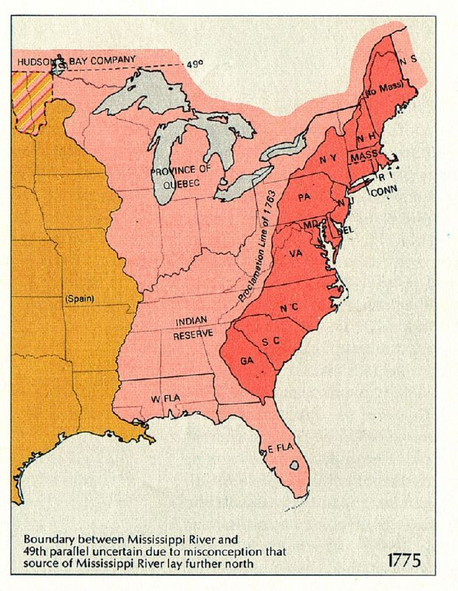
PROCLAMATION OF 1763
Colonist could not cross into western lands – one of the main reasons the colonist wanted to defeat the French.
Colonial anger directed at the British reasons for the American Revolution.

Slide 30
CAUSES OF THE AMERICAN REVOLUTION
The American Revolution | The War Begins | Foreign Support and British Defeat
French and Indian War drained British treasury. Stamp Act: Britain passed and enforced new tax law on the colonists “No taxation without representation.” Colonists felt entitled to the rights of English citizens. | First Continental Congress meets in 1774 with 13 colonies Fighting begins at Lexington and Concord in 1775. George Washington Commander in Chief Second Continental Congress signs the Declaration of Independence: July 4, 1776. Writer = Thomas Jefferson | French supplied arms, officers and money to rebels Spain and Dutch Republic entered the war against Great Britain. British surrender in 1781 with Treaty of Paris Recognized American independence Americans gain control of western territory from Appalachians to Mississippi River.

Slide 31
CAUSES OF THE AMERICAN REVOLUTION
British taxed colonies to pay for French and Indian War.
Stamp Act (1765) – required that certain printed materials such as legal documents, newspapers and playing cards, carry a stamp saying that a tax had been paid to Britain.
Tea Act – Tea could be purchased only from British merchants and was also taxed.
Boston Tea Party
Intolerable Acts – closed Boston Harbor, rescinded Massachusetts charter, quartered troops in private homes.
Declaration of Independence

Slide 32
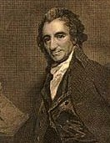
COMMON SENSE AND THE DECLARATION OF INDEPENDENCE
In January of 1776 an Englishman named Thomas Paine published a small book called Common Sense. The book said all kings in general, especially George III of England, were bad. The book also stated that America must be free. This book became a best-seller. It made Americans believe that America should be a free and independent nation.

Slide 33
DECLARATION OF INDEPENDENCE
Drafted by Thomas Jefferson
People had the right to “alter or abolish unjust governments.”
Popular sovereignty All government power comes from the people.
King had trampled the peoples’ natural rights.
Colonists now had the right to rebel.
Right’s come from “Nature” not man. These rights are inherent and we are born with them.

Slide 34
THE CONSTITUTION
Used ideas of Locke, Montesquieu, Rousseau and Voltaire
Created a Federal Republic
Government in which power is divided between the national, or federal government, and the states.
Separation of powers
Bill of Rights added later.
Federalist Papers – Writing campaign to convince American citizens to ratify the new Constitution
George Washington – first President of the United States of America.

Slide 35
POPULAR SOVEREIGNTY
People
Rule
The people hold supreme rule – elected officials

Slide 36
LIMITED GOVERNMENT
The power of the government is limited by the Constitution.
The process of creating laws is set forth in the Constitution.
The powers and duties of all government branches are determined by the Constitution.

Slide 37
REPUBLICANISM
A republic is a nation governed by elected representatives.
These representatives may be removed from office by a vote if they abuse their powers.

Slide 38
FEDERALISM
Federal: national defense, immigration, foreign policy, national issues.
Federalism: Power shared between national and state governments. National government takes the lead in running the country.
State: local education, licenses, safety, state taxation, etc.
Supremacy Clause: state laws
cannot usurp nation laws

Slide 39
BILL OF RIGHTS
Anti-Federalists
In a number of states, Federalists won the battle over ratification only because they had offered to support several amendments to the Constitution designed to promote citizen’s rights. These 10 amendments came to be called the Bill of Rights.

